Slide 1

GOOGLE FILE SYSTEM
Name: Vaka Prasanna
Roll No: 20BQ1A05O6
Section: 4-CSE-D
Subject: BIG DATA ANALYTICS

Slide 2
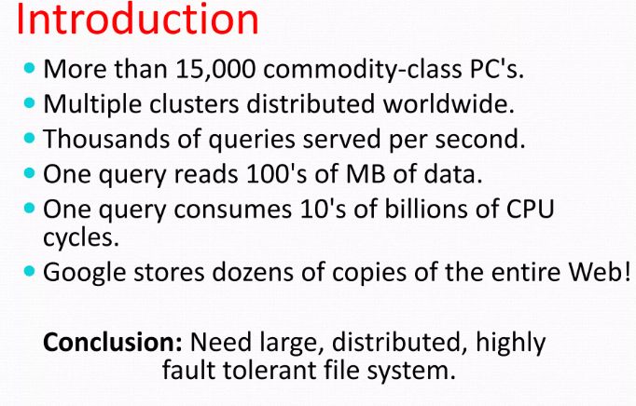
Need of Google File System:

Slide 3
Google File System Overview
Google Inc. developed the Google File System (GFS).
Google File System grew out of an earlier Google effort, "BigFiles", developed by Larry Page and Sergey Brin.
It is a scalable distributed file system (DFS), to meet the company’s growing data processing needs.
GFS offers many features to big networks and connected nodes. They include:
Fault tolerance
Dependability
Scalability
Availability
Performance

Slide 4
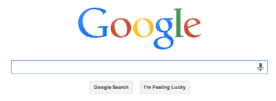
Google File System
GFS is made up of a number of storage systems constructed from inexpensive commodity hardware parts.
The search engine, which creates enormous volumes of data that must be kept, is only one example of how it is customized to meet Google’s various data use and storage requirements.
GoogleFS is another name for GFS.
It manages two types of data :
1)File metadata
2)File Data.

Slide 5
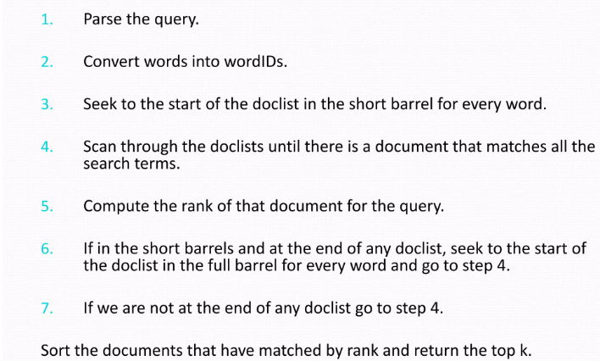
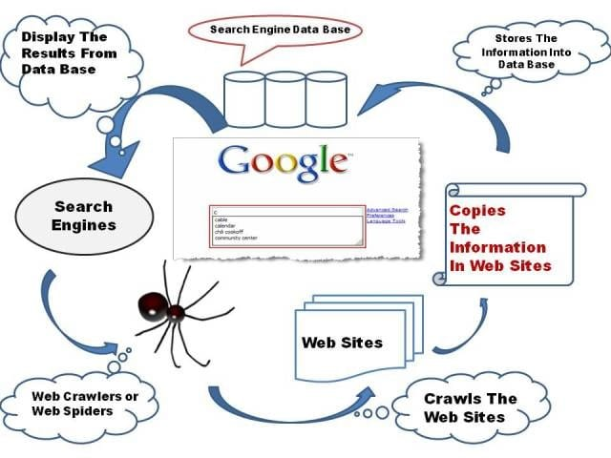
Working of Google Search Engine:

Slide 6
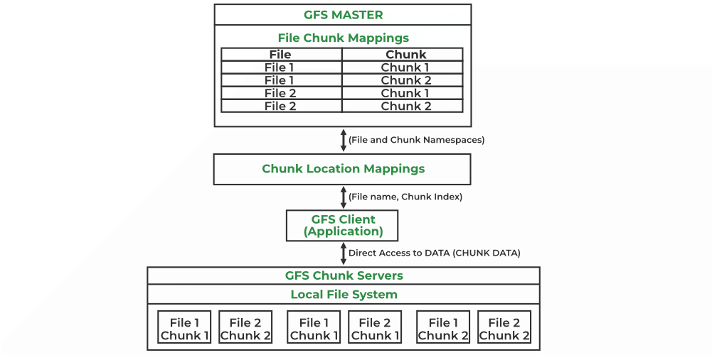
Google File System
Files are divided into fixed-size chunks of 64 megabytes, similar to clusters in regular file systems.
A GFS cluster consists of multiple nodes.
These nodes are divided into 2 types:
i) Master Node
ii) A large number of Chunk servers.
Each file is divided into fixed-size chunks.
Chunk servers store these chunks.

Slide 7
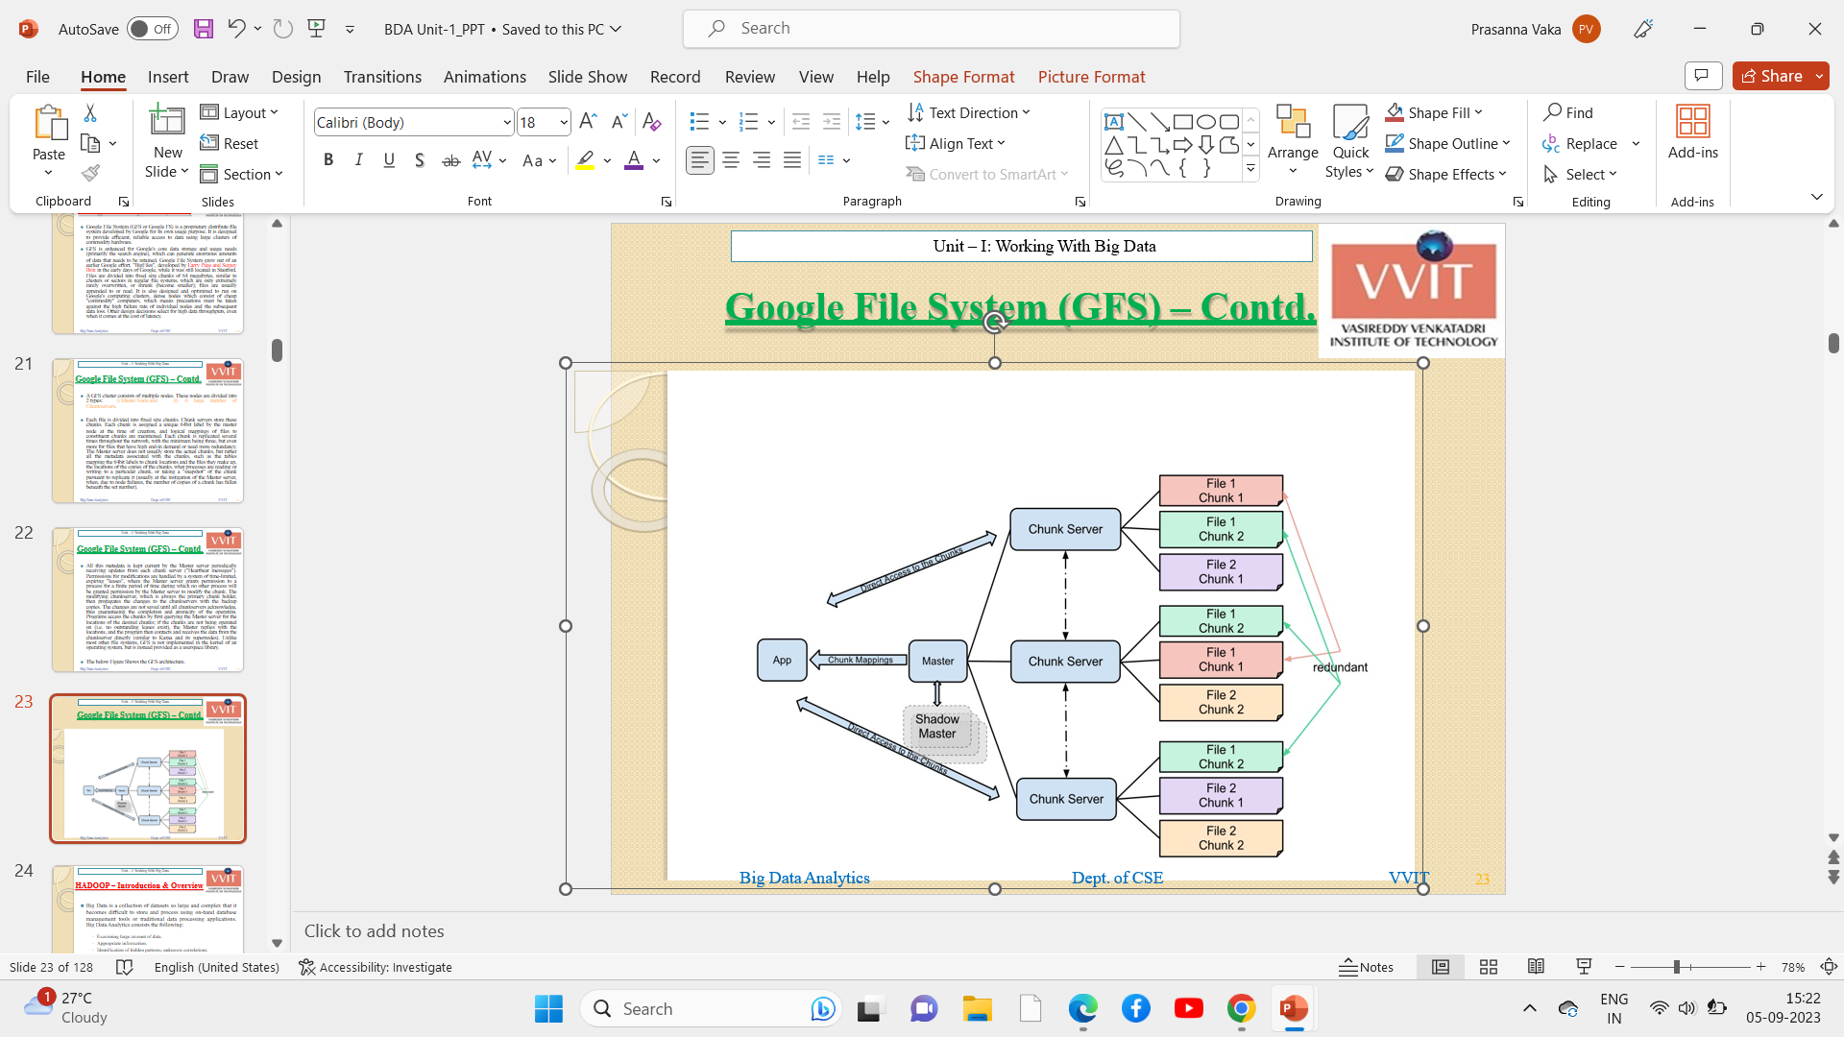
Google File System (GFS) Architecture
The below Figure Shows the GFS architecture

Slide 8
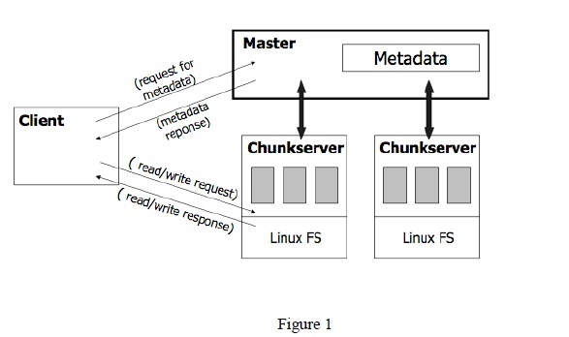
Google File System
Each chunk is assigned a unique 64-bit label by the master node at the time of creation.
Each chunk is replicated several times throughout the network with the minimum being three, but even more for files that have high end-in demand or need more redundancy.
The Master server does not usually store the actual chunks, but rather all the metadata associated with the chunks .All this metadata is kept current by the Master server periodically receiving updates from each chunk server ("Heartbeat messages").
Permissions for modifications are handled by a system of time-limited, expiring "leases“.

Slide 9
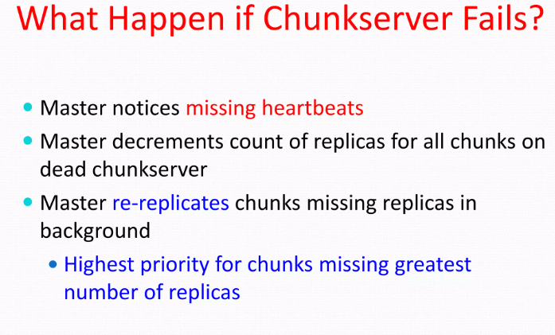

Slide 10
Google File System
The changes are not saved until all chunk servers are acknowledged.
Programs access the chunks by first querying the Master server for the locations of the desired chunks.
If the chunks are not being operated on (i.e. no outstanding leases exist), the Master replies with the locations, and the program then contacts and receives the data from the chunk server directly.
Unlike most other file systems, GFS is not implemented in the kernel of an operating system but is instead provided as a user-space library.

Slide 11
Features of Google File System:
Namespace management and locking.
Fault tolerance.
Reduced client and master interaction because of large chunk server size.
High availability.
Critical data replication.
Automatic and efficient data recovery.
High aggregate throughput.

Slide 12
Advantages of Google File System:
High accessibility Data is still accessible even if a few nodes fail. (replication) Component failures are more common than not, as the saying goes.
Excessive throughput. many nodes operating concurrently.
Dependable storing. Data that has been corrupted can be found and duplicated.

Slide 13
Disadvantages of Google File System:
Not the best fit for small files.
Master may act as a bottleneck.
unable to type at random.
Suitable for procedures or data that are written once and only read (appended) later.

Slide 14
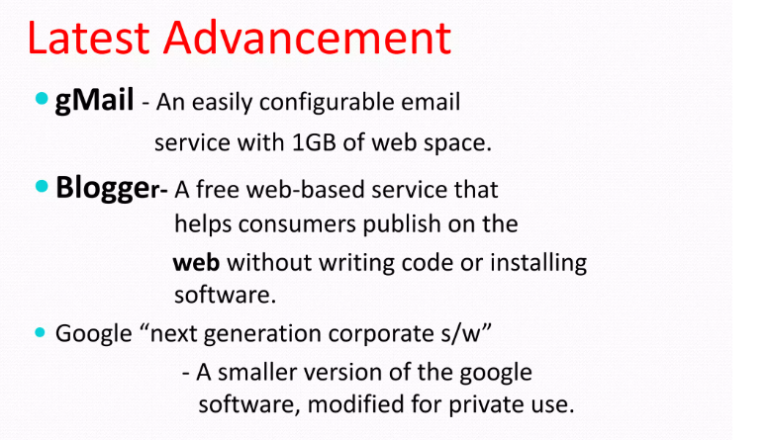

Slide 15


